Slide 1


Sonic Pi

Slide 2
Learning Objectives
Getting started with Sonic Pi
Making songs using Sonic Pi
Tweaking Sounds using Sonic Pi
Generating Sounds using Sonic Pi
Saving and exporting Sonic Pi tracks

Slide 3
Introduction To Sonic Pi
Sonic Pi is an open-source programming environment, designed to explore and teach programming concepts through the process of creating new sounds.
It’s a free live coding synth (short for synthesizer) for everyone created by Sam Aaron at the University of Cambridge Computer Laboratory.
One can use Sonic Pi to program, compose and perform in classical and contemporary styles ranging from Canons to Dubstep.

Slide 4
Installation
It is available for Windows, OS X, Raspberry pi and Linux operating systems.
To install, go to http://sonic-pi.net/ and choose the setup file that suites your operating system.

Slide 5
Sonic Pi Interface
Sonic Pi interface has three main windows:
  Programming Panel: The largest of them all and is used for writing your code.
  Log panel: Displays the information of your as it runs.
  Help window: This window appears when you click the help button which is located at the top of your screen. It appears along the bottom displaying help documentation and contains information about the language for programming Sonic Pi as well as different synth sounds, samples, and etc.
Plenty of ready-to-go examples are available and free for use.

Slide 6
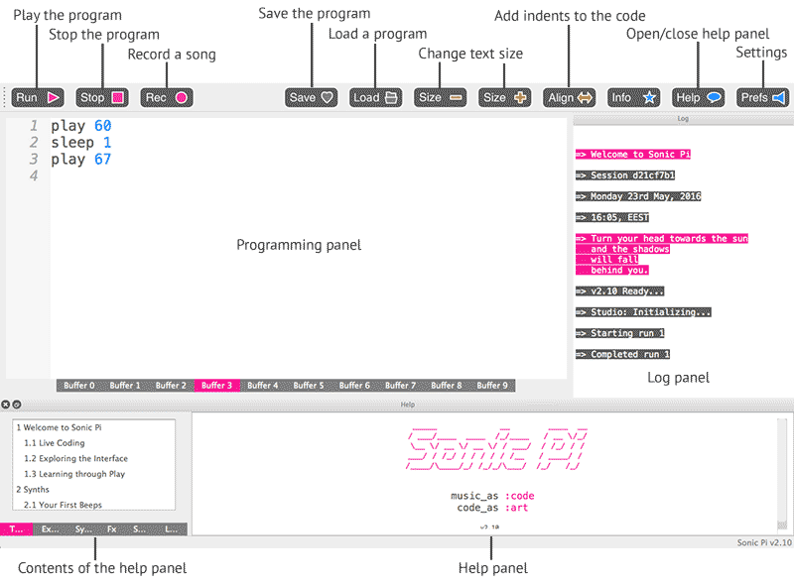
Look And Feel Of The Interface

Slide 7
Get Familiar With Some Terminologies
A synthesizer (synth): an electronic musical instrument, typically operated by a keyboard, producing a wide variety of sounds by generating and combining signals of different frequencies.
Amplitude (amp): Is the loudness of a sound.
Pan: Is controlling the panning of a sound in stereo i.e. which speaker (right, left or both) receives the melody.
Cutoff: Is removing the frequencies that are higher that the given value
Attack: Is playing a sound from a lower to a higher amplitude.
Release: Is playing a sound from a higher to a lower amplitude.
Sustain: Is playing a sound at an amplitude that was set by the attack for some time before release.
Decay: Is the phase that fits between the attack and sustain phases. It specifies the time where the amplitude will drop from the attack_level: to the decay_level: (which unless you explicitly set it will be set to the sustain_level:).

Slide 8
Sources and References
http://sonic-pi.mehackit.org/exercises/en/01-introduction/01-introduction.html
http://sonic-pi.net/

